Slide 1

how do species interactions shape ecosystem collapse?
fernando cagua — 02.2016 — doctoral confirmation centre for integrative ecology, school of biological sciences, university of canterbury
Notes:
My thesis is about understanding how interactions shape ecosystem resilience and how they can help us understand the functioning of the ecosystem
I'm going to explain a couple of concepts that provide a backbone of my thesis
mention outline

Slide 2
regime shifts
reconfiguration of ecosystem structure + function
Notes:
Importance of ecosystems

Slide 3
coexistence theory
stabilizing + destabilizing mechanisms
Notes:
The first is coexistence theory, proposed by Peter Chesson on the late 90s

Slide 4
stabilizing + destabilizing mechanisms
stable coexistence
fitness equivalence
competitive exclusion
strength of stabilization
Adler et al. 2006 Ecol. Lett. 10:2 Chesson 2000 Annu. Rev. Ecol. Evol. Syst. 31:1
Notes:
it states that coexistence is achieved when stabilising forces like niche differentiation balance destabilising forces like fitness equivalence
so the beauty of this framework is that it boils down coexistence to competitive traits of species so that species tend to coexiste when interspeciefic competition is smaller than intraspecific competition

Slide 5
Bascompte & Jordano 2007 Annu. Rev. Evol. Ecol. Syst. 38:1 Klein et al. 2007 Proc. Royal Soc. B 274:1608
Notes:
the second backbone is that I’m focusing on mutualistic interactions like those existing between plants and pollinators.
while it’s very important for some ecosystem services in particular food production and biodiversity, mutualism has been much less studied compared to competition

Slide 6

interacting with invasive species
Notes:
invasions are one of the major drivers of global change.
over the last years we have been doing good progress on understanding the causes and consequences of invasions but it has been focused on negative interactions
even though empirical evidence suggest that the establishment of an invasive can be greatly enhanced by a positive relationship
I want to understand how the structure affects the invasibility of the pollination communities

Slide 7

pollinators
what’s the structure
?
plants
Notes:
implications both for the stability and and the number of coexisting species can be changed when invasive species enter the community

Slide 8
pollinators
nested structure
plants
Fortuna et al. 2010 J. Anim. Ecol. 79:4
Notes:
nestedness is pervasive to plant pollination communitues. it is when …
has been shown that nested structures facilitate coexistence and delay the onset of catastrophic regime shifts

Slide 9
pollinators
modular structure
plants
Fortuna et al. 2010 J. Anim. Ecol. 79:4
Notes:
modules are ”compartments” of closely interacting species, related to trait matching and pollination syndromes.
limits the spread of disturbances

Slide 10
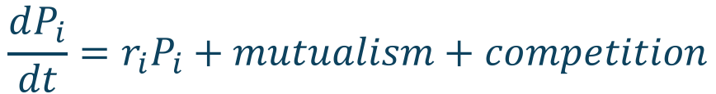
models of mutualistically interacting species
$$\frac{dP_{i}}{dt}=r_{i}P_{i}+mutualism+competition$$
Garcia-Algarra et al. 2013 J. Theor. Biol. 363 Lever et al. 2014 Ecol. Lettr. 17:3
Notes:
for answering this question I will work with models of the community.
the abundnaces of species is modelled as a function of the positive effects of mutualism and the negative effects of competition
in the coexistence framework mutualism work as a stabilising force

Slide 11
objective 1
how does network structure shapes community “invasibility”?
?
Romanuk et al. 2009 Phil. Trans. R. Soc. B 364:1524
Notes:
I will use these models to answer the main question of this chapter, which is blah
as the structure of the networks is so important determining the number of coexisting species and the stability of mutualistic networks it makes sense it has also an important effect on the invasibility of the ecosystems.
differences between plant and pollinators

Slide 12
objective 1
how does network structure shapes community “invasibility”?
invasibility
invasibility
nestedness
modularity
Bastolla et al. 2009 Nature 458:7241
Notes:
There is some expectations on nestedness based on previous theoretical work, we have no idea what’s the effect of modularity thoigh

Slide 13
objective 2
how resilient are communities to invasions?
species’abundance
time
Ives & Carpenter 2010 Science 317:5834
Post & Pim 1983 Math. Biosc. 64:2
Notes:
the second component of this chapter is to use the same models I bult to examin invasibility to see what happens after. to what extent this represent a small shift or a major regime shift or collapse

Slide 14

redundancy in mutualistic communities
Notes:
redundancy is usually seen as a positive thing in ecosystems as it provides an insurance from loss. Example finances and engineering.
redundancy has been proposed to be a key factor contributing to community persistence because of portfolio effect
variability of the community is smaller than variability of single species
most in antagonistic networks, but we don’t know how redundancy works in mutualistic interactions

Slide 15

+
+
Notes:
mutualism is special because interactions are though to have positive consequences

Slide 16
pollinators
plants
Bastolla et al. 2009 Nature 458:7241

Slide 17
interspecific pollen transfer
Morales & Traveset 2008 Crit. Rev. Plant Sci. 27:4
Notes:
despite being widely awcknoledged empirically, competition of pollination it has not been integrated into standard models of mutualism

Slide 18
objective 1
integrate competition for pollination in models of mutualism
redundancy
Bastolla et al. 2009 Nature 458:7241
Notes:
My hypotheis is that this mechanims, by affecting the effects of redundancy can explain the patterns observed in natural communities. Which is a level of redundancy that balances between minimising the competitive effects while maximising the positive ones

Slide 19
objective 2
what’s the scale of redundancy that explains observed structures?
redundancy
Stouffer et al. 2014 J. Ecol. 102
Notes:
another scale of redundancy is local. Any mutualistic network can be assembled using this three motifs of interactions, we can look at them as building blocks for the pollination community.
I’ll analyse the stability of these three modules independently and then their contribution to the whole network stability with and without competition for pollination.

Slide 20
objective 2
what’s the scale of redundancy that explains observed structures?
species in stable coexistence
high nestedness
connectance / global redundancy
Bastolla et al. 2009 Nature 458:7241
Notes:
how they are as a pattern and the consequences for stability – there is empirical evidence but no mechanism that explains the observed structures

Slide 21
objective 3
does it delay or accelerate phase sifts?
+/-
-
+
+
+
+
Lever et al. 2014 Ecol. Lettr. 17:3
Notes:
finally I want to evaluate

Slide 22
objective 3
does it delay or accelerate phase sifts?
+/-
-
+/-
+/-
+
+

Slide 23

driver species to manage ecological networks
Notes:
in the third chapter I want to explore how structural patterns of species interactions could be used for management and restoration

Slide 24


Slide 25
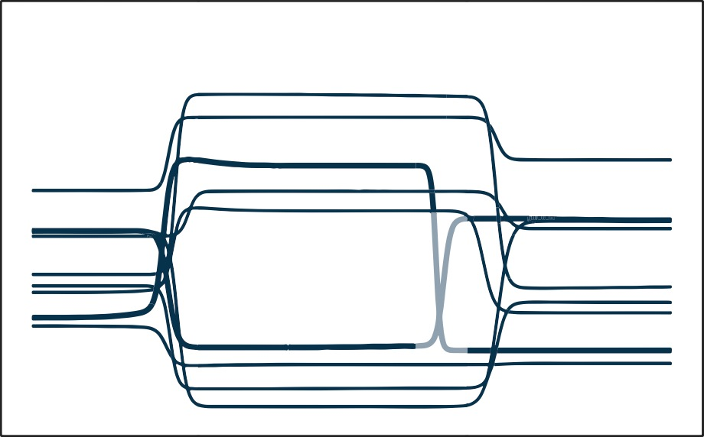
regime shift
targeted intervention

Slide 26
which species?
Notes:
trivial solution to control the state of the ecosystem would be to manage every single species in the community. that’s infeasible and unrealistic,
find species like the sea otter and focus management interventions on those species

Slide 27
which species?
as predator
as prey
a
a
b
b
A
c
c
D
B
E
d
d
C
e
e
maximum matching
Liu et al. Nature 473:7346
Notes:
used to find minimum sets in diverse areas or graph theory, image processing and computational chemistry
here I use an example with species as predator and preys because it’s easier to understand
one species needs to be managed if it’s not being matched by another one

Slide 28
which species?
as predator
as prey
a
a
b
b
A
c
c
D
B
E
d
d
C
e
e
maximum matching

Slide 29
which species?
as predator
as prey
a
a
b
b
A
c
c
D
B
E
d
d
C
e
e
maximum matching

Slide 30
which species?
Species | Frequency
A | 100%
B | 66%
C | 0%
D | 66%
E | 66%
A
D
B
E
C

Slide 31
6
invaded
uninvaded
Photo by Julien Lagarde Lopezaraiza-Mikel et al. 2007 Ecol. Lett. 10:7 Bartomeus et al. 2008 Oecologia 155:4

Slide 33
Bascompte et al. Science 312

Slide 34
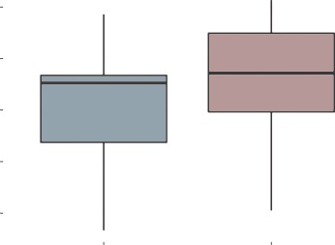
% of species that needs to be controlled
75%
6
invaded
70%
uninvaded
65%
60%
55%
uninvaded
invaded
Manuscript in preparation
Presented at Marine and Human Systems Conference, Trieste, Italy

Slide 35
relative importance of species
1.00
6
invaded
0.75
0.50
0.25
0.00
communities
Manuscript in preparation
Presented at Marine and Human Systems Conference, Trieste, Italy

Slide 36
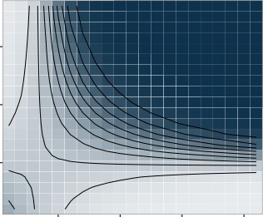
relative importance of species
6
0.75
invaded
uninvaded
0.25
strength of dependencies
0.50
0.50
0.75
0.25
5
10
15
20
degree
Manuscript in preparation
Presented at Marine and Human Systems Conference, Trieste, Italy

Slide 37
Jenny Sahng

Slide 38
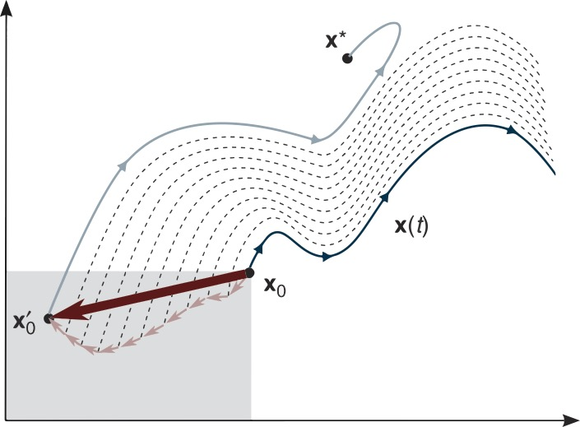
desired ecosystem trajectory
designing the interventions
undesired ecosystem trajectory
targeted interventions
feasible region
Cornelius et al. Nat. Commun. 4

Slide 39

co-phylogeny of pollination networks

Slide 40

Matthew Hutchinson

Slide 41
pollinators
do modules have an evolutionary signature?
modules are pervasive in mutualistic communities
plants
Manuscript under review Presented at the Ecological Society of America Annual Meeting, Baltimore, USA

Slide 42
thank you
supervised by Daniel Stouffer & co-supervised by Jason Tylianakis
special thanks to Jenny Sahng, Matthew Hutchinson, Bernat Bramon, and Marilia Gaiarsa funded by the University of Canterbury Doctoral Scholarship, the New Zealand International Doctoral Research Scholarship, and a Meadow Mushrooms Postgraduate Scholarship conference travel aid provided by Royal Society of New Zealand (through Daniel Stouffer), the European Space Agency, and the Australian Society for fish Biology

